Slide 1


SMART HOME SECURITY SYSTEM
Project in One Sentence
Design and Simulation
of a Smart Home Security System
A circuit that checks door, window, and motion sensors, counts active sensors, selects a security rule, and turns on an alarm only when armed.
Presented by group -11
Jasmitha - 2620040033
Harshini - 2620040066
Harshith – 262004011
Lohith - 2620040023
Final 1-bit output: 1 = alarm ON, 0 = alarm OFF

Slide 2


FOUNDATION
Introduction and Objective
What problem are we modelling, and what should the circuit do?
Introduction
Output and Rule
Sensor Inputs
A home can have several possible entry points. Door, window, and motion sensors provide simple ON/OFF signals. Digital logic combines these signals to decide whether a possible intrusion should trigger an alarm.
Alarm output: 1 = alarm ON; 0 = alarm OFF. The alarm sounds only when the system is armed and the selected security condition is satisfied.
Door (D)
1 = open; 0 = closed
Window (W)
Logic convention: A logic value of 1 means ON/active and a logic value of 0 means OFF/inactive throughout this project.
1 = open; 0 = closed
Project Objective
Motion (M)
Build a digital circuit that counts active sensors, applies one of two security rules, and blocks the alarm whenever the system is disarmed.
1 = movement detected; 0 = no movement
Control Inputs
Arming Switch
1 = security ON; 0 = OFF
Mode Selector
0 = normal mode; 1 = strict mode

Slide 3
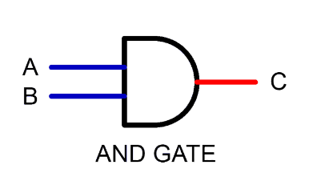
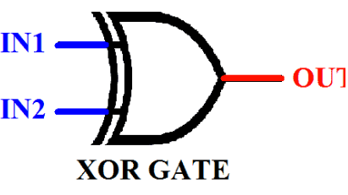
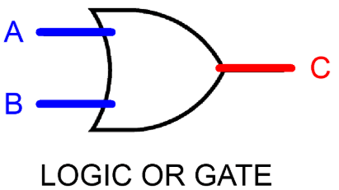
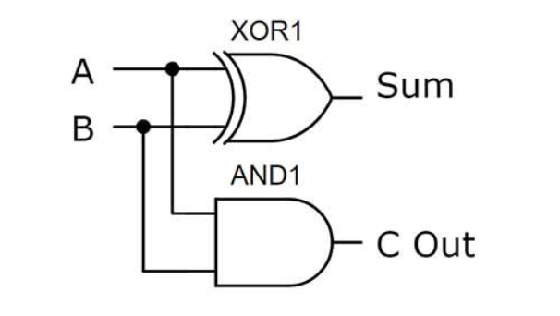

LOGIC MODEL
Theory and Logic Circuit
How the sensor counter and security decision work
1. Half-Adder 1 — Inputs: Door (D) and Window (W)
Output | Expression | Meaning
Sum₁ | D XOR W | 1 when inputs differ
Carry₁ | D AND W | 1 when both are 1
Circuit Diagram Placeholder
Half-Adder 1 Half-Adder 2 OR Gate AND Gate
2. Half-Adder 2 — Inputs: Sum₁ and Motion (M)
Output | Expression | Meaning
CountLow | Sum₁ XOR M | Low bit of sensor count
Carry₂ | Sum₁ AND M | Second carry signal
3. OR Gate — Count High Bit
CountHigh = Carry₁ OR Carry₂
The two bits together count active sensors from 0 to 3:

Slide 4
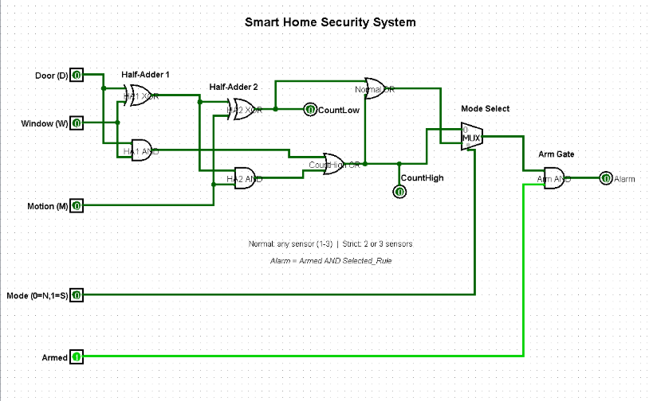
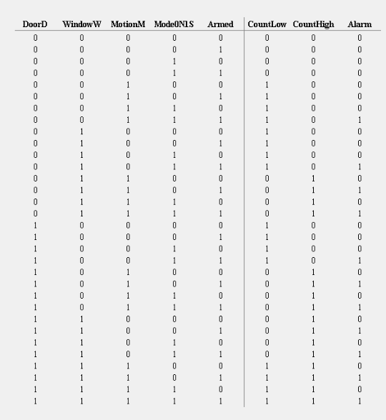
IMPLEMENTATION
Boolean Expressions
Circuit Design in Logisim
Signal | Expression
CountLow | (D XOR W) XOR M
CountHigh | (D AND W) OR ((D XOR W) AND M)
Normal condition | CountHigh OR CountLow
Strict condition | CountHigh
Selected alarm | MUX(Normal, Strict, Mode)
Alarm | Armed AND Selected alarm
Implementation, signal path, and Boolean expression
Signal Path
01
Sensor Inputs
Door, window, and motion inputs enter the circuit
02
Half-Adder 1
D + W → produces Sum₁ and Carry₁
03
Half-Adder 2
Sum₁ + M → produces CountLow and Carry₂
04
OR Gate
Combines Carry₁ and Carry₂ to form CountHigh
05
Select = 0 chooses normal mode; Select = 1 chooses strict mode. The selector does not arm the system.
Multiplexer
Selects normal or strict rule based on Mode selector
06
AND Gate
Combines selected signal with Armed switch
07
Alarm Output
Final 1-bit alarm result

Slide 5
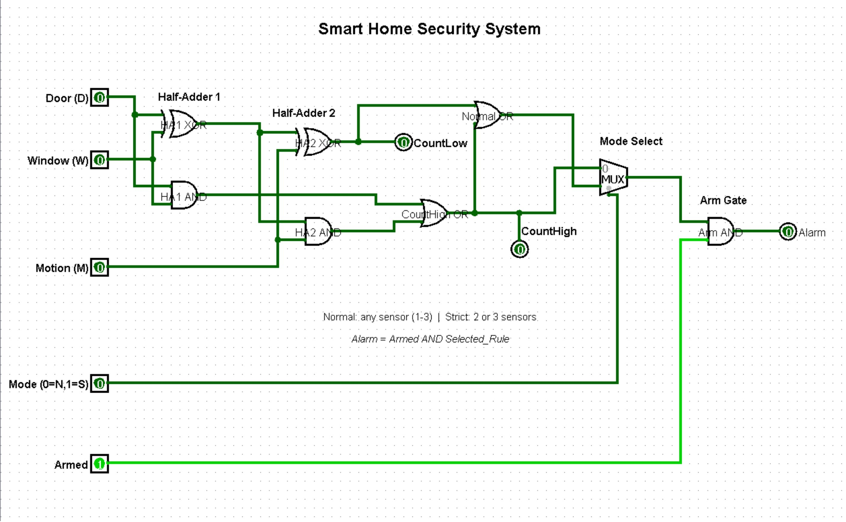



Slide 6
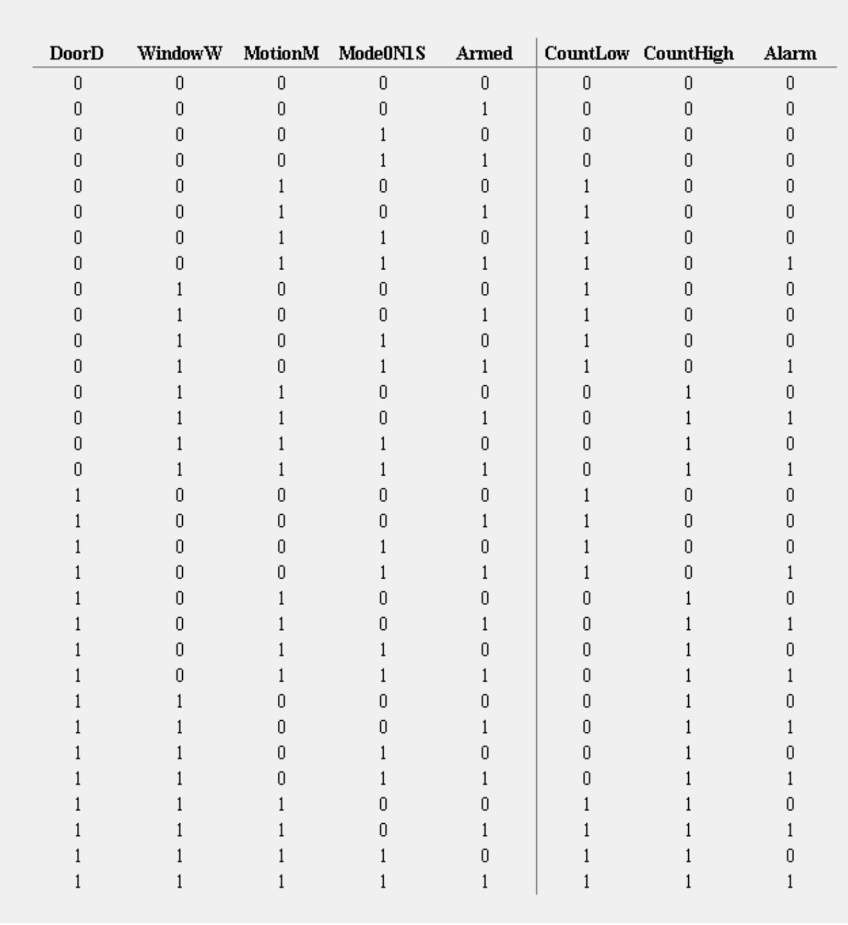


Slide 7

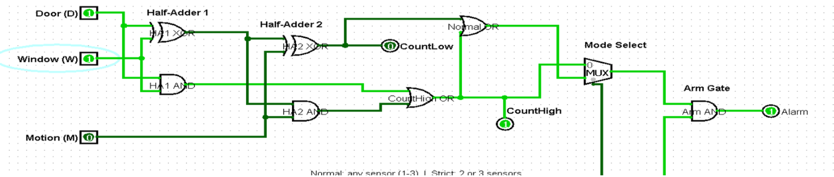
VERIFICATION
How to Test
Simulation Results
Arm the System
Truth Table — Sensor Count vs. Mode
Set Armed = 1 to test alarm responses
Active Sensors | Count (High, Low) | Normal Mode | Strict Mode
None | 0 0 | OFF | OFF
One sensor | 0 1 | ON | OFF
Two sensors | 1 0 | ON | ON
Three sensors | 1 1 | ON | ON
Change Mode
Mode = 0 for normal; Mode = 1 for strict
Disarm Test
With Armed = 0, alarm is OFF for every sensor combination
Troubleshoot
If output differs, check the MUX select pin, sensor inputs, and arming switch
Truth Table / Extra Test Evidence Placeholder
Strict modetriggers for 1, 2, or 3 active sensors. Normal mode
triggers only for 2 or 3 active sensors.
Insert your full truth table or additional Logisim screenshots here. Include the three sensor inputs, mode selection, arming switch, and expected alarm output.

Slide 8

CLOSE
Applications
Conclusion and Applications
Homes & Apartments
Laboratories & Offices
Small Storage Rooms
Conclusion
Sensors represent doors, windows, and movement in a protected area.
Half-adders count the active sensors; the OR gate combines carry signals.
The multiplexer selects normal or strict mode.
The final AND gate ensures the alarm only works when armed.
The project demonstrates half-adders, XOR, OR, AND, and multiplexer logic in one design.
The same logic concept can be adapted to other protected areas.
Possible Improvements
Limitation
Siren / Notification Output
More Sensors
This is a digital logic simulation, not a complete real alarm. A real installation also needs physical sensors, power, a siren driver, and safe installation.
Add a real siren or notification output for physical alerting
Include additional sensor inputs to cover more entry points
Delay or Entry Code
Real Hardware
Add a delay timer or PIN-based entry code for usability
Test the circuit with real hardware after safe design review

